Slide 1
RECURRENCE RELATION

Slide 2
ALGORITHM DESIGNING APPROACH
There are two approaches which can be used to write algorithms:
Incremental (insertion sort)
Divide and Conquer (Merge sort, Quick sort)

Slide 3
RECURRENCE
For large value of input size, recursive algorithms gives exponential running time complexity.
When an algorithm contains a recursive call to itself, then its running time can be described by a recurrence equation or recurrence.
Following algorithms are recursive algorithms:
  Fibonacci series calculation
  Factorial calculation
  Binary Search
  Merge Sort

Slide 4
SOLVING RECURRENCES
Solving recurrences means the asymptotic evaluation of their efficiency.
The recurrence can be solved using some mathematical tools and then bounds (big-O, big-Ω, and big-Θ) on the performance of the algorithm should be found according to the corresponding criteria.

Slide 5
COMPOSING RECURRENCES FOR DIVIDE AND CONQUER ALGORITHMS
A recurrence for the running time of a divide-and-conquer algorithm is based on the three steps:
1) Let T(n) be the running time of a problem of size n. If the problem size is small enough (n≤c) for some constant c, the straightforward solution takes constant time, which we write as Θ(1)

Slide 6
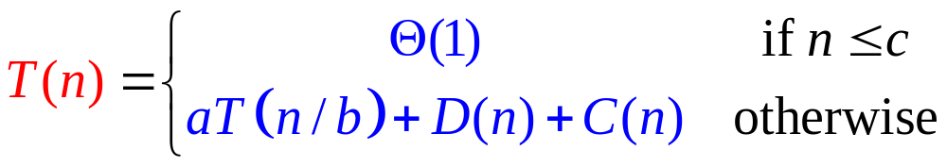
COMPOSING RECURRENCES
2) Suppose that our division of the problem yields a subproblems, each of which is 1/b size of the original.
3) If we take D(n) time to divide the problem into subproblems and C(n) time to combine the solutions to the subproblems to the original problem, we got the recurrence

Slide 7
SOLVING RECURRENCES
Hence, solving recurrences means finding the asymtotic bounds (big-O, big-Ω, and big-Θ) for the function T(n).

Slide 8
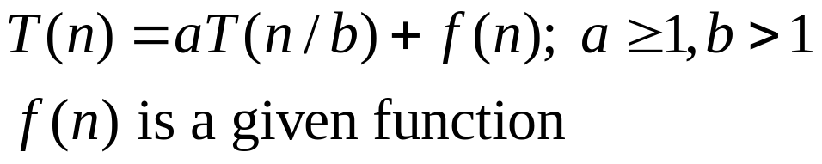
SOLVING RECURRENCES
Recursion-tree method converts recursion into a tree whose nodes represent the “subproblems” and their costs.
Substitution method – we guess a bound and then use mathematical induction to prove our guess.
Master method provides bounds for recurrences of the form :

Slide 9
RECURSION TREE METHOD
A recursion tree is used to present a problem as a composition of subproblems. It is very suitable to present any divide-and-conquer algorithm.
Each node represents the cost of a single subproblem.
Usually each level of the tree corresponds to one step of the recursion.

Slide 10
RECURSION TREE
We sum the costs within each level of the tree to obtain a set of per-level costs.
Then we sum all the per-level costs to determine the total cost of all levels of the recursion.
As a result, we generate a guess that can be then proven either by substitution method or by master theorem method.

Slide 11
SOLVING RECURRENCES : THE MASTER THEOREM
Given: a divide and conquer algorithm
  An algorithm that divides the problem of size n into a subproblems, each of size n/b.
  Let the cost of each stage (i.e., the work to divide the problem + combine solved subproblems) be described by the function f(n).
Then, the Master Theorem gives us a some rules for the algorithm’s running time:

Slide 12
SOLVING RECURRENCES :THE MASTER METHOD
Provides the immediate solution for recurrences of the form
f(n) is a given function, which satisfies some pre-determined conditions.

Slide 13
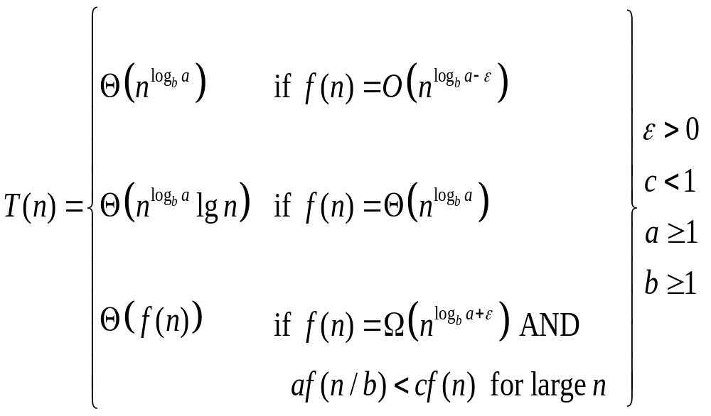
THE MASTER THEOREM
if T(n) = aT(n/b) + f(n) then

Slide 14
EXAMPLE : USING THE MASTER METHOD
T(n) = 9T(n/3) + n
  a=9, b=3, f(n) = n
  n^{logb a} = n^{log3 9} = n²
  Since f(n) = n= O(n^{log3 9 - ε}), where ε =1,case 1 applies:
  Thus the solution is T(n) = Θ(n²)

Slide 15
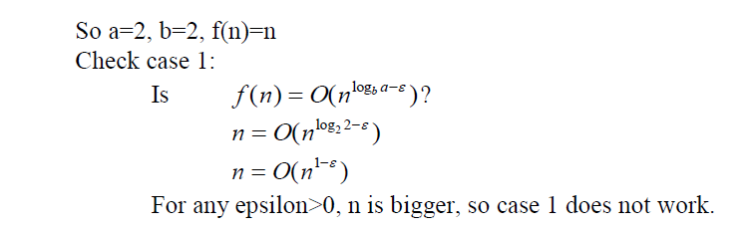
USING THE MASTER METHOD
T(n) = 2T(n/2) + n

Slide 16
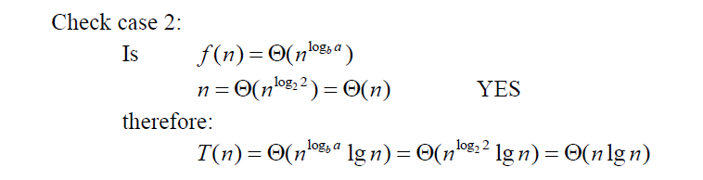
USING THE MASTER METHOD
T(n) = 2T(n/2) + n

Slide 17
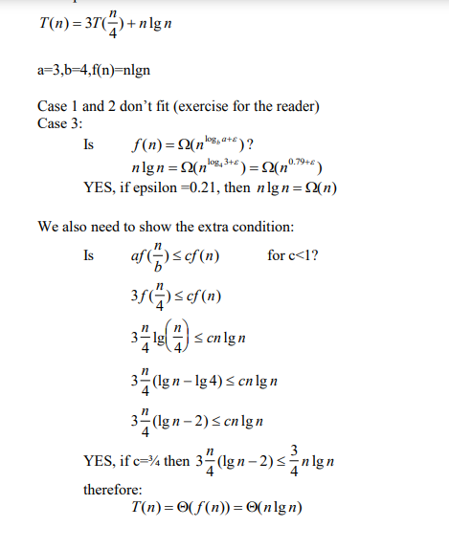

Slide 18
